Slide 1

Simulation of light scattering and propagation
# HW4
Group 6
陳政霆 (Leon)
陳彥霖 (Eric)
Belén Casajús

Slide 2

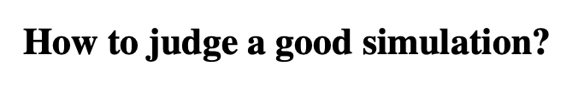

Slide 3
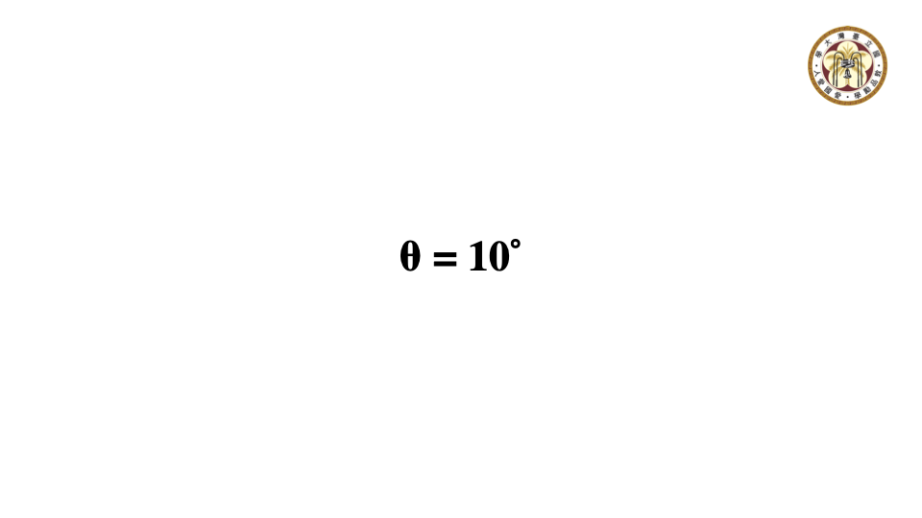
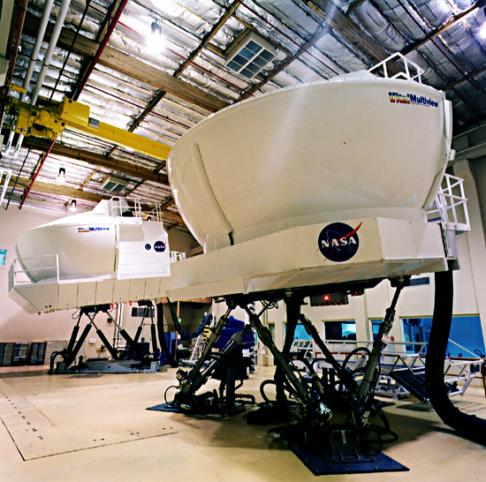

What is simulation?
A simulation imitates the operation of real world processes or systems with the use of models. The model represents the key behaviours and characteristics of the selected process or system while the simulation represents how the model evolves under different conditions .
Why we need simulation?
safety benefits
economic benefits
Notes:
>>Take “flight simulator” for example
>>The simulator can provide a high level of complex operation functions equivalent to the equipment, allowing students to have sufficient time to think in a safe environment, to learn the opportunity for trial and error and correction.
Also,
>>simulator can perform rehearsal of actual actions or tasks, fully familiarize with and predict possible situations, increase the ability to handle special situations and shorten the reaction time, which is helpful to complete the task.

Slide 4
How to judge a good simulation?
Efficient code
Simulation results conform to the laws of physics in the real world
Consider all variables that can have a significant impact
Achieve safety or economic benefits
Notes:
>>so how do we judge a good simulation?
there are 4 important points:

Slide 5
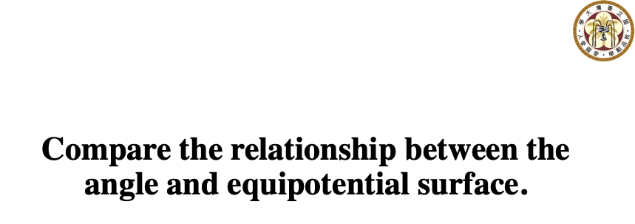

Slide 6
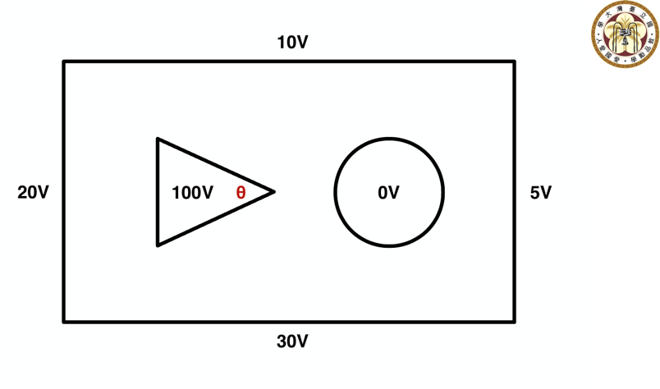
Figure 1. Basic simulation properties

Slide 7
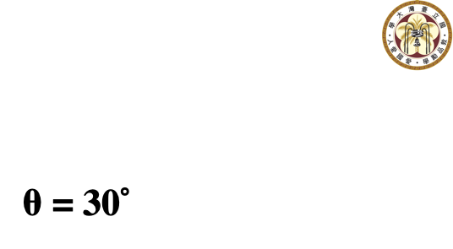

Slide 8
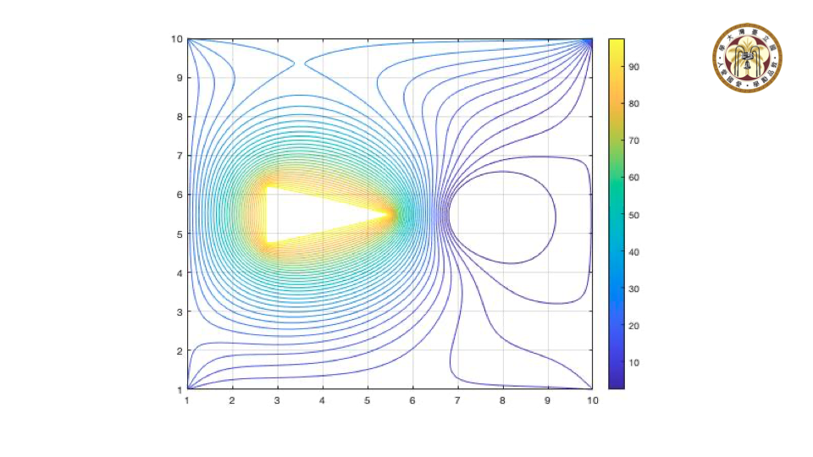
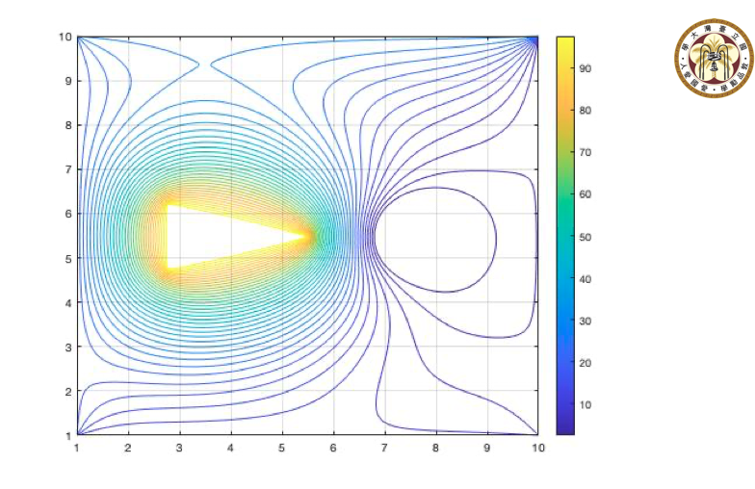
Figure 2. 2D field plot for 30˚

Slide 9
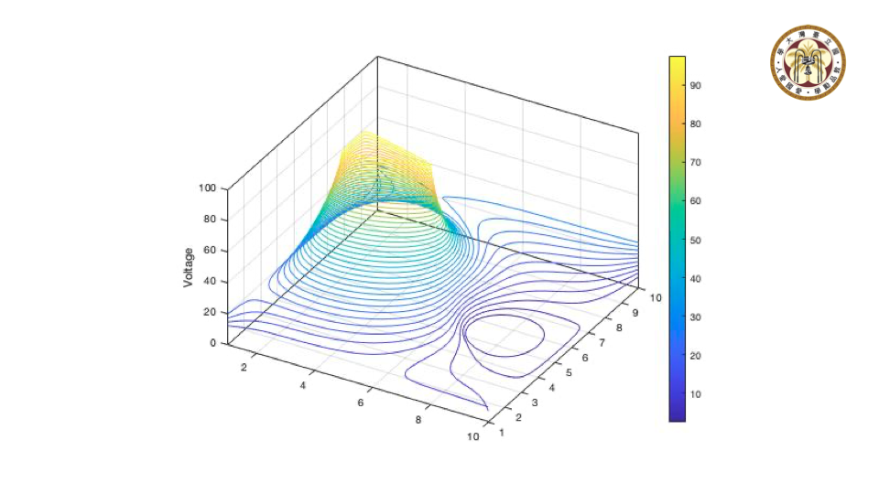
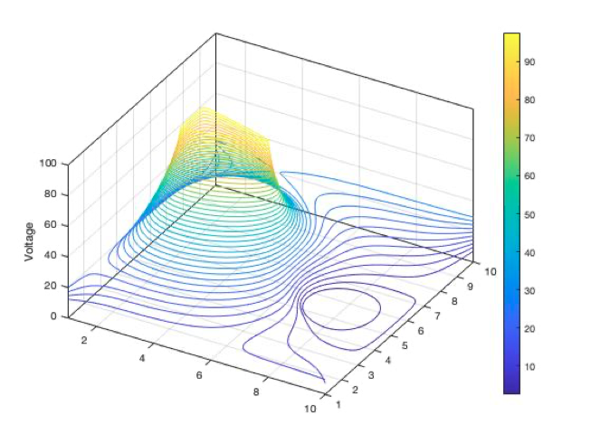
Figure 3. 3D field plot for 30˚

Slide 10
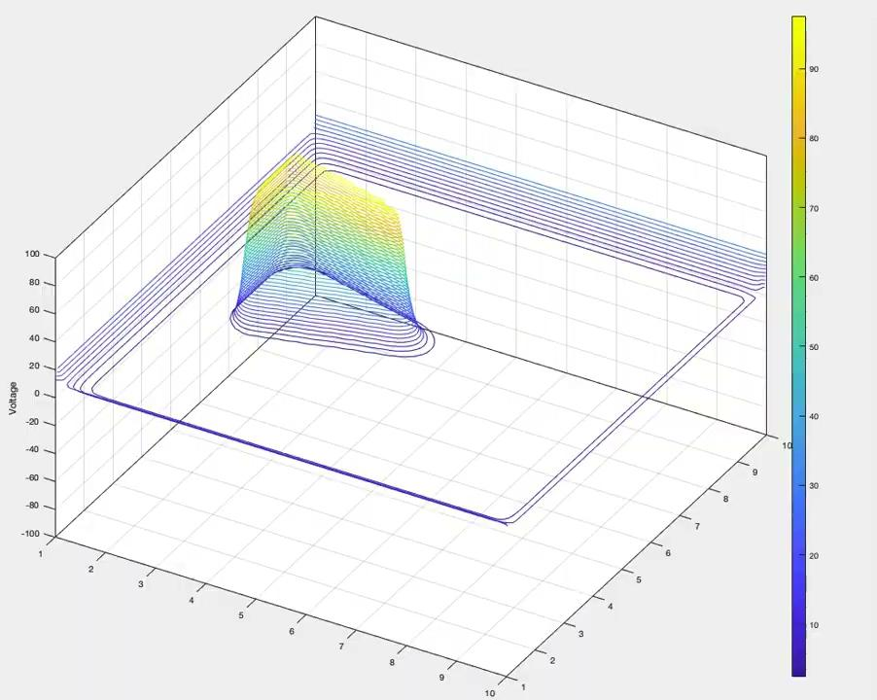
Figure 4. 3D field plot for 30˚

Slide 12
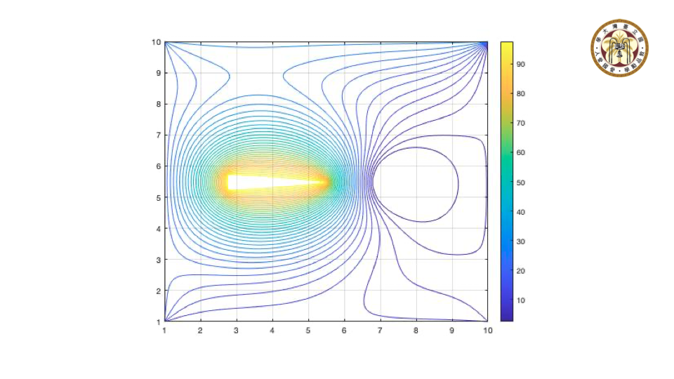
Figure 5. 2D field plot for 10˚

Slide 13
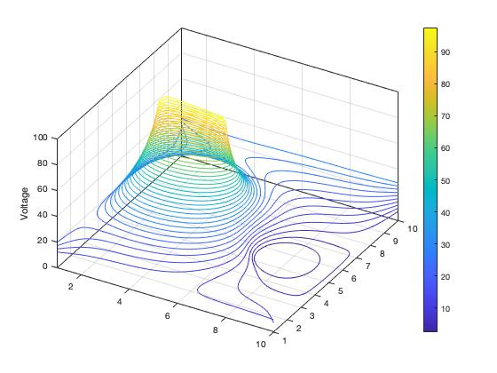
Figure 6. 3D field plot for 10˚

Slide 14
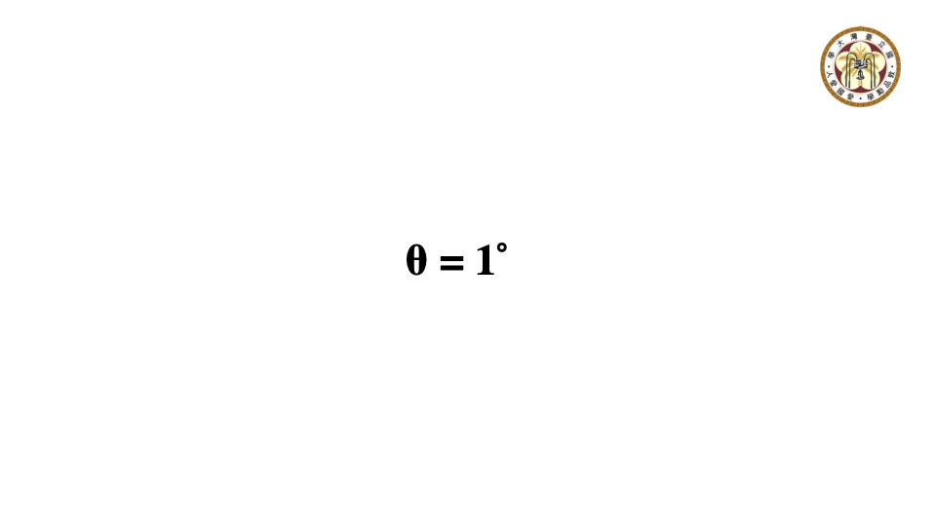
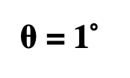

Slide 15
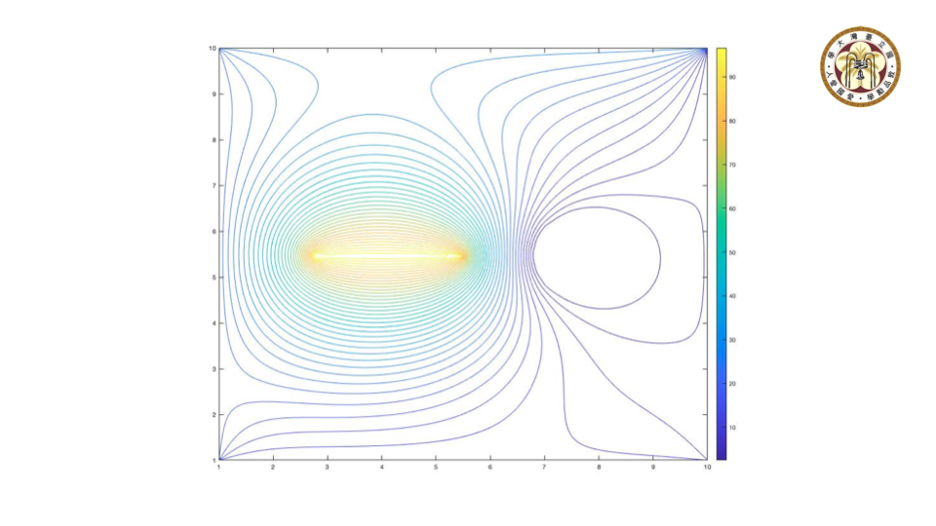
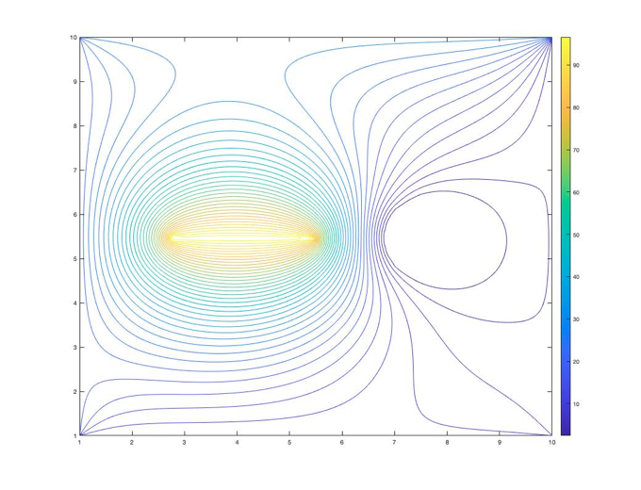
Figure 7. 2D field plot for 1˚

Slide 16
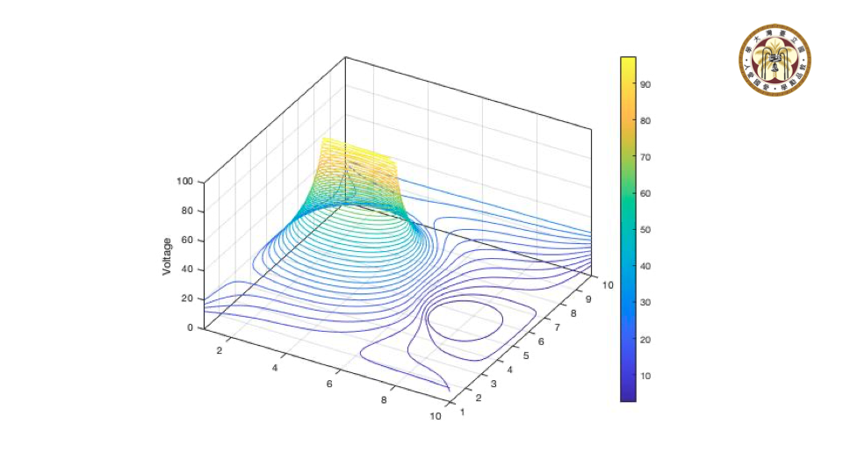
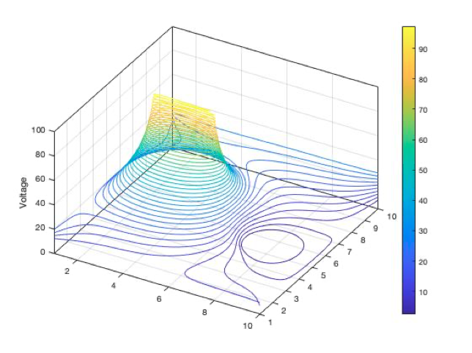
Figure 8. 3D field plot for 1˚

Slide 17
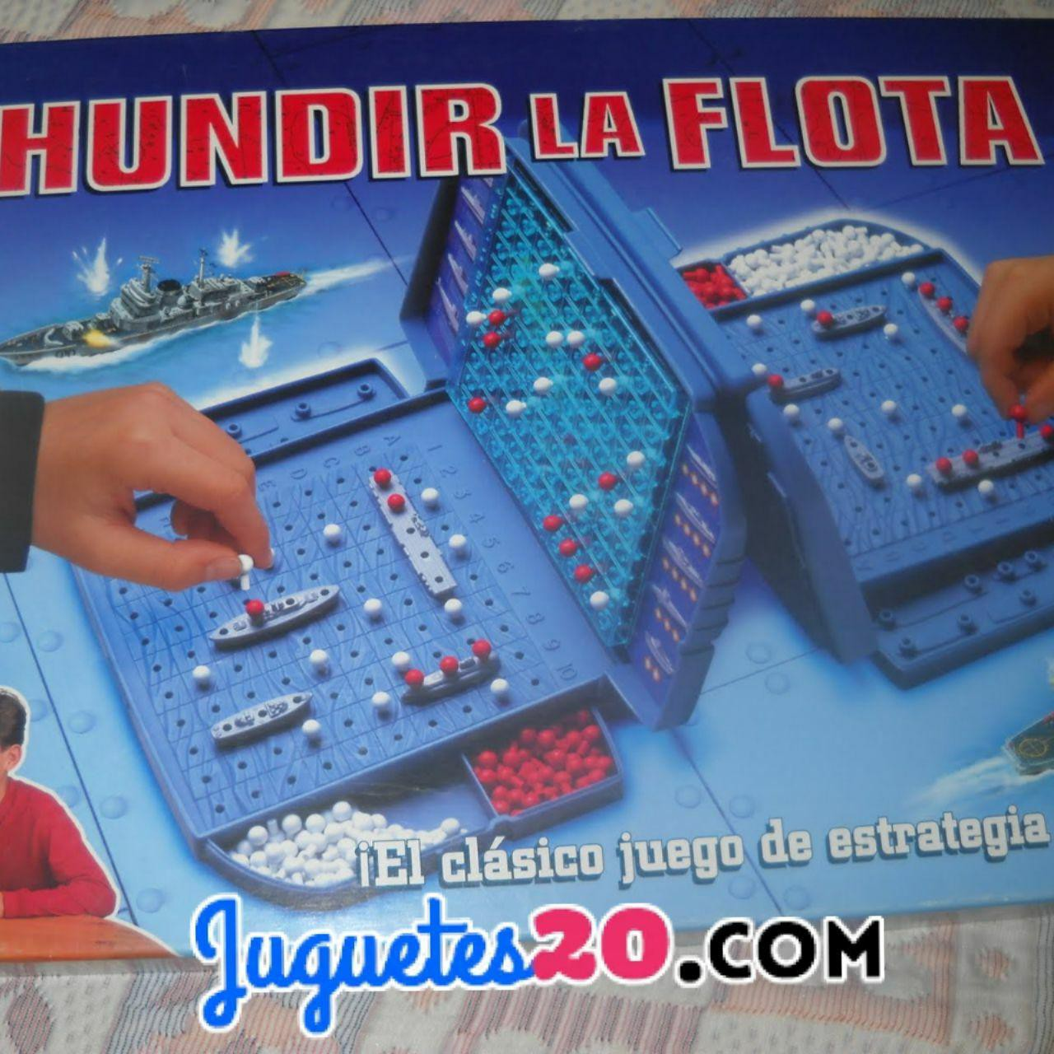
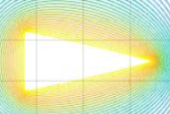
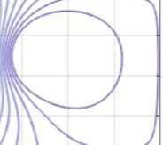
2-2 The relationship between the angle and equipotential surface
1.
V, φ → Volt
E →Volt per Meter (V/m)
1.
2.

Slide 18
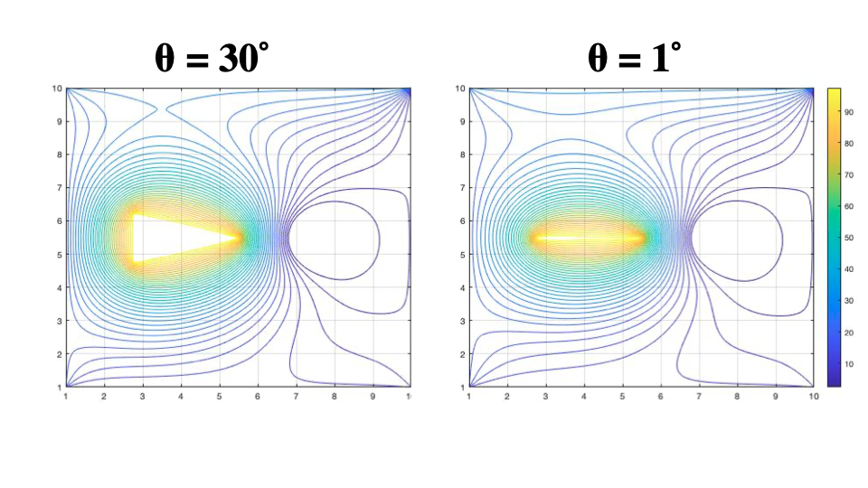
Figure 9. Comparison between 30˚ and 1˚

Slide 19
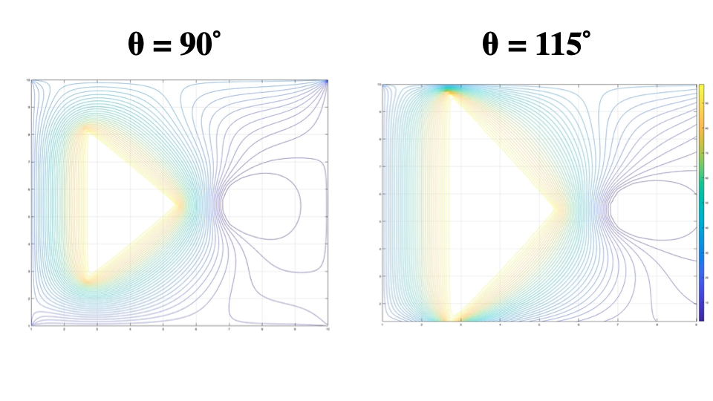
Figure 10. Comparison between 90˚ and 115˚

